Slide 1
CHAPTER 17
Macroeconomic and Industry Analysis

Slide 2
Fundamental Analysis
A firm’s value comes from its earnings prospects, which are determined by:
  The global economic environment
  Economic factors affecting the firm’s industry
  The position of the firm within its industry

Slide 3
The Global Economy
Stock markets around the world responded in unison to the financial crisis of 2008.
Performance in countries and regions can be highly variable.
It is harder for businesses to succeed in a contracting economy than in an expanding one.

Slide 4
The Global Economy
Political risk:
  The global environment may present much greater risks than normally found in U.S.-based investments.
Exchange rate risk:
  Changes the prices of imports and exports.

Slide 5
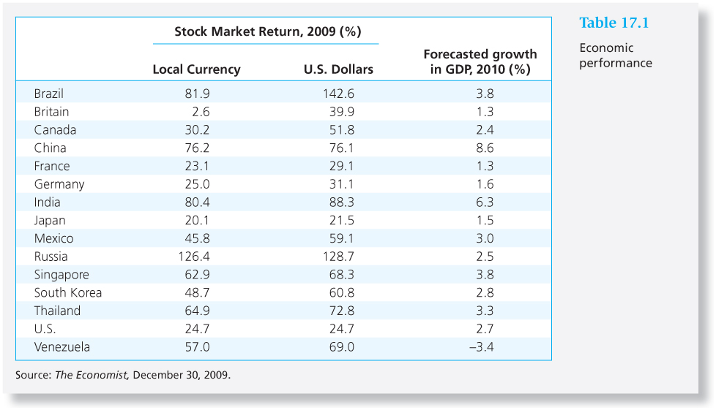
Table 17.1 Economic Performance

Slide 6
The Domestic Macroeconomy
Stock prices rise with earnings.
P/E ratios are normally in the range of 12-25.
The first step in forecasting the performance of the broad market is to assess the status of the economy as a whole.

Slide 7
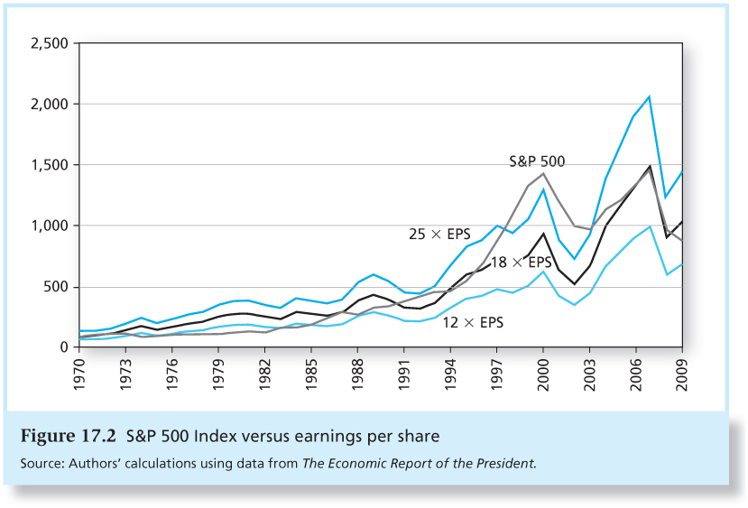
Figure 17.2 S&P 500 Index versus Earnings Per Share

Slide 8
The Domestic Macroeconomy:
Key Variables
Gross domestic product
Unemployment rates
Inflation
Interest rates
Budget deficit
Consumer sentiment

Slide 9
Demand and Supply Shocks
Demand shock - an event that affects demand for goods and services in the economy
Supply shock - an event that influences production capacity or production costs

Slide 10
Demand-side Policy
Fiscal policy – the government’s spending and taxing actions
Monetary policy – manipulation of the money supply

Slide 11
Fiscal Policy
Most direct way to stimulate or slow the economy
Formulation of fiscal policy is often a slow, cumbersome political process

Slide 12
Fiscal Policy
To summarize the net effect of fiscal policy, look at the budget surplus or deficit.
Deficit stimulates the economy because:
  it increases the demand for goods (via spending) by more than it reduces the demand for goods (via taxes)

Slide 13
Monetary Policy
Manipulation of the money supply to influence economic activity.
Increasing the money supply lowers interest rates and stimulates the economy.
Less immediate effect than fiscal policy
Tools of monetary policy include open market operations, discount rate, reserve requirements.

Slide 14
Supply-Side Policies
Goal: To create an environment in which workers and owners of capital have the maximum incentive and ability to produce and develop goods.
Supply-siders focus on how tax policy can be used to improve incentives to work and invest.

Slide 15
Business Cycles
The transition points across cycles are called peaks and troughs.
  A peak is the transition from the end of an expansion to the start of a contraction.
  A trough occurs at the bottom of a recession just as the economy enters a recovery.

Slide 16
The Business Cycle
Cyclical Industries
Defensive Industries
Above-average sensitivity to the state of the economy.
Examples include producers of consumer durables (e.g. autos) and capital goods (i.e. goods used by other firms to produce their own products.)
High betas
Little sensitivity to the business cycle
Examples include food producers and processors, pharmaceutical firms, and public utilities
Low betas

Slide 17
Economic Indicators
Leading indicators tend to rise and fall in advance of the economy.
Coincident indicators move with the market.
Lagging indicators change subsequent to market movements.

Slide 18
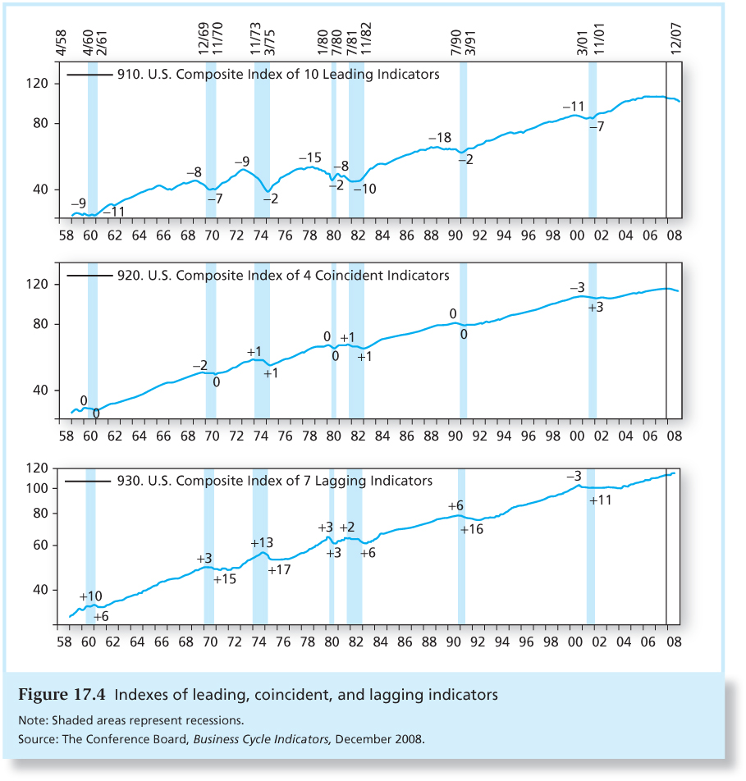
Figure 17.4 Indexes of Leading,
Coincident, and Lagging Indicators

Slide 19
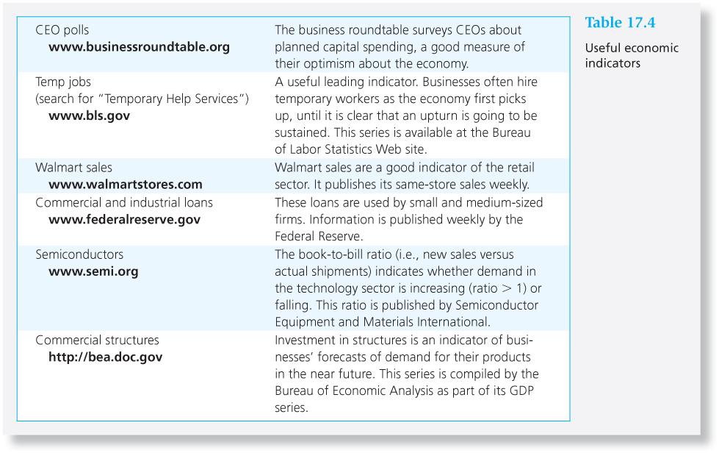
Table 17.4 Useful Economic Indicators

Slide 20
Economic Calendar
Many sources, such as The Wall Street Journal and Yahoo! Finance, publish the public announcement dates of various economic statistics.

Slide 21
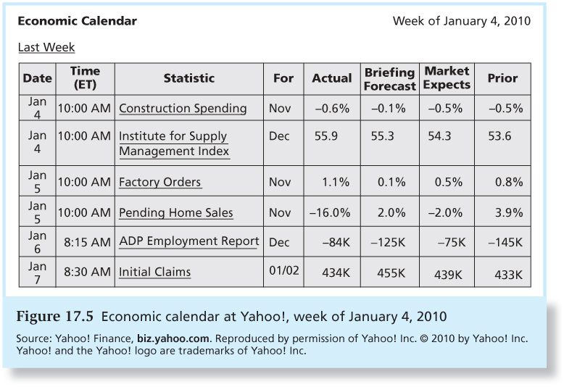
Figure 17.5 Economic Calendar at Yahoo!

Slide 22
Industry Analysis
It is unusual for a firm in a troubled industry to perform well.
Economic performance can vary widely across industries.

Slide 23
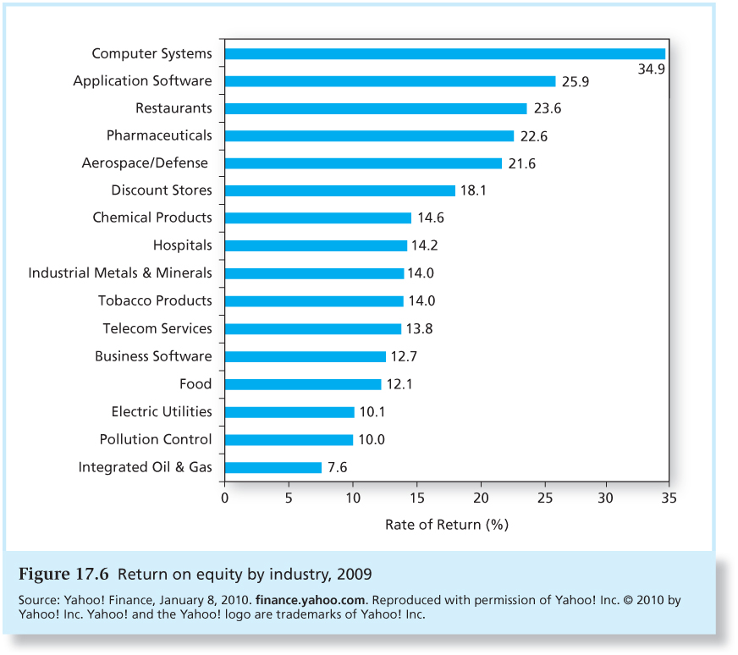
Figure 17.6 Return on Equity, 2009

Slide 24
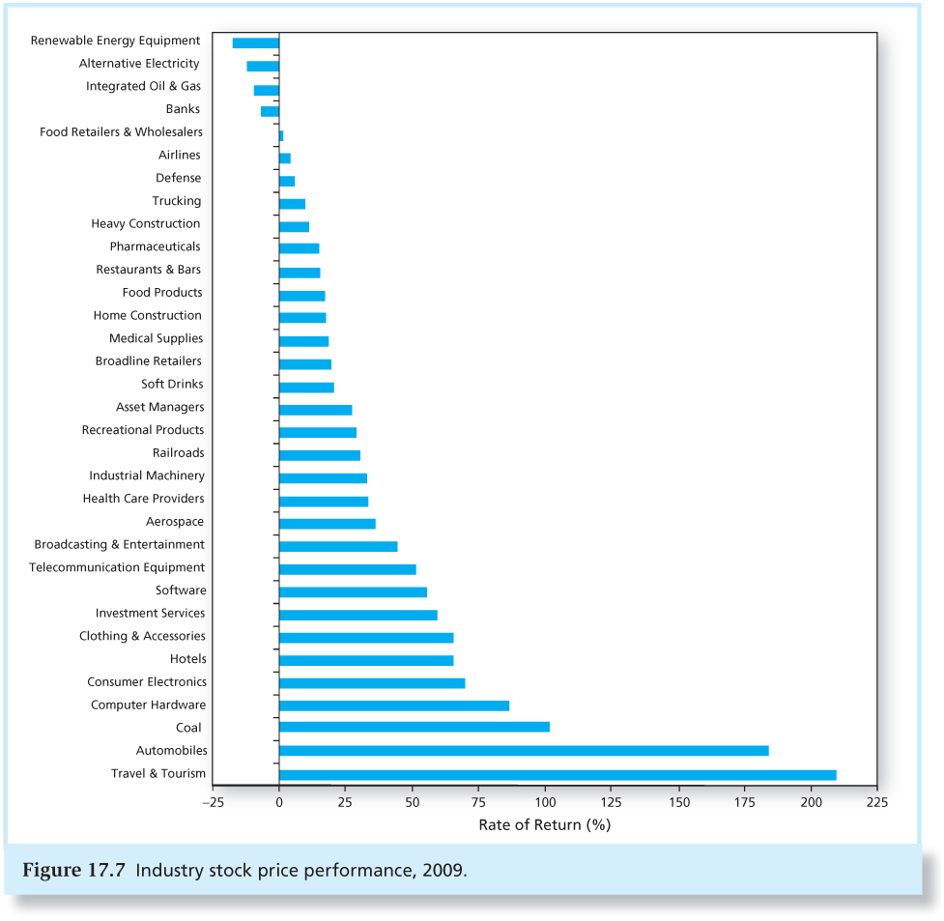
Figure 17.7 Industry Stock Price Performance, 2009

Slide 25
Defining an Industry
North American Industry Classification System, or NAICS codes
Firms with the same four-digit NAICS codes are commonly taken to be in the same industry.

Slide 26
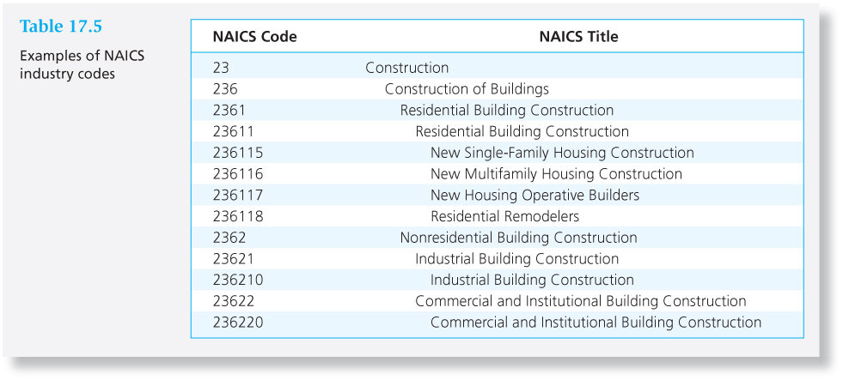
Table 17.5 Examples of NAICS Industry Codes

Slide 27
Sensitivity to the Business Cycle
Sensitivity of sales:
  Necessities vs. discretionary goods
  Items that are not sensitive to income levels (such as tobacco and movies) vs. items that are, (such as machine tools, steel, autos)
Three factors determine how sensitive a firm’s earnings are to the business cycle.

Slide 28
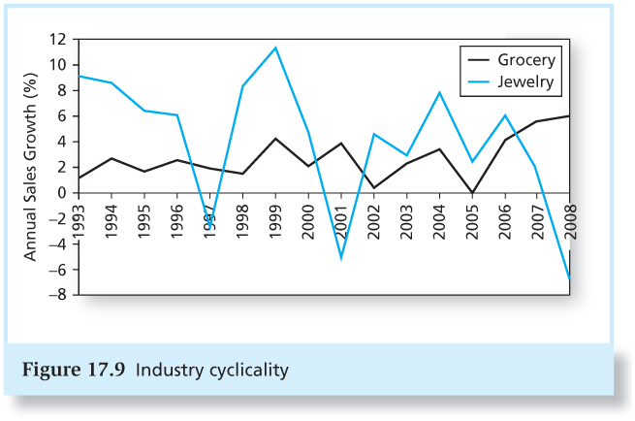
Figure 17.9 Industry Cyclicality

Slide 29
Sensitivity to the Business Cycle
Operating leverage : the split between fixed and variable costs
Firms with low operating leverage (less fixed assets) are less sensitive to business conditions.
Firms with high operating leverage (more fixed assets) are more sensitive to the business cycle.

Slide 30
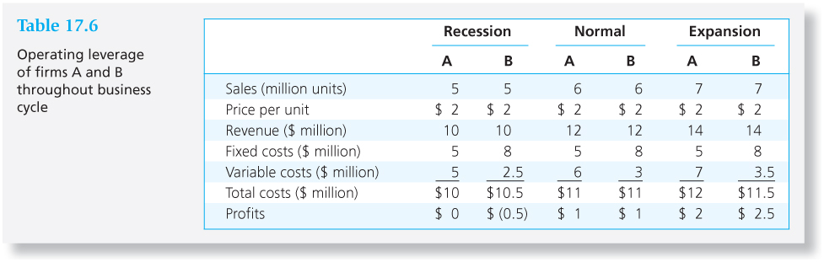
Table 17.6 Operating Leverage of Firms A and B Throughout the Business Cycle

Slide 31
Sensitivity to the Business Cycle
Financial leverage: the use of borrowing
Interest is a fixed cost that increases the sensitivity of profits to the business cycle.

Slide 32
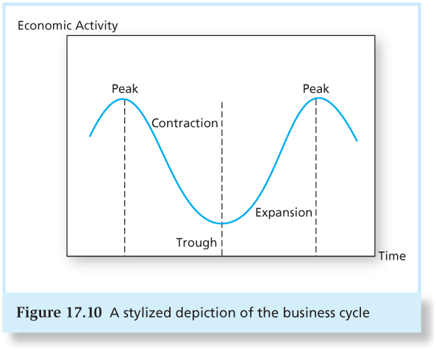
Figure 17.10 A Stylized Depiction of the Business Cycle

Slide 33
Sector Rotation
Portfolio is shifted into industries or sectors that should outperform, according to the stage of the business cycle.
Peaks – natural resource extraction firms
Contraction – defensive industries such as pharmaceuticals and food

Slide 34
Sector Rotation
Trough – capital goods industries
Expansion – cyclical industries such as consumer durables

Slide 35
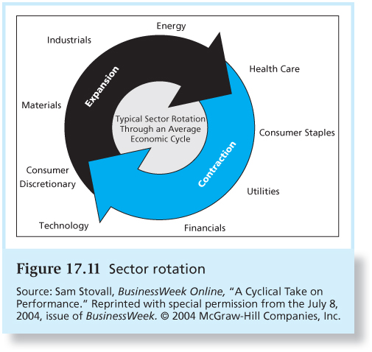
Figure 17.11 Sector Rotation

Slide 36
Industry Life Cycles
Stage
Sales Growth
Start-up
Consolidation
Maturity
Relative Decline
Rapid and increasing
Stable
Slowing
Minimal or negative

Slide 37
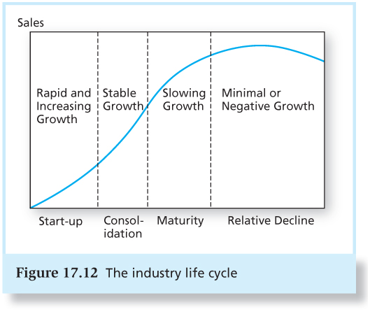
Figure 17.12 The Industry Life
Cycle

Slide 38
Which Life Cycle Stage is Most Attractive?
Quote from Peter Lynch in One Up on Wall Street:
" Many people prefer to invest in a high-growth industry, where there’s a lot of sound and fury. Not me. I prefer to invest in a low-growth industry. . . .

Slide 39
Which Life Cycle Stage is Most Attractive?
…In a low-growth industry, especially one that’s boring and upsets people [such as funeral homes or the oil-drum retrieval business], there’s no problem with competition. You don’t have to protect your flanks from potential rivals . . . and this gives you the leeway to continue to grow.”
Peter Lynch in One Up on Wall Street

Slide 40
Industry Structure and Performance:
Five Determinants of Competition
Threat of entry
Rivalry between existing competitors
Pressure from substitute products
Bargaining power of buyers
Bargaining power of suppliers

